Slide 1
CSC1003 Practice 1
JDK, VSCode and HelloWorld

Slide 2
Overview
Install JDK: Java Development Kit
Install VSCode: Code editor
Run your first program

Slide 3
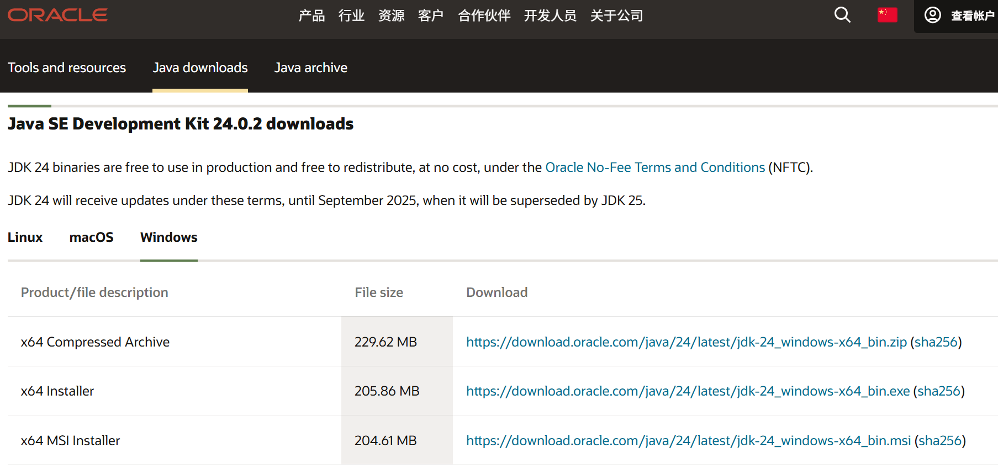
Download JDK - Windows
Download Microsoft OpenJDK 24:
https://www.oracle.com/cn/java/technologies/downloads/#jdk24-windows

Slide 4
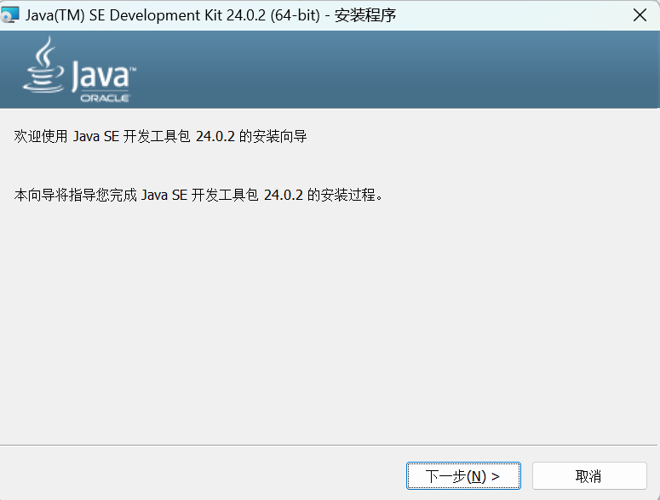
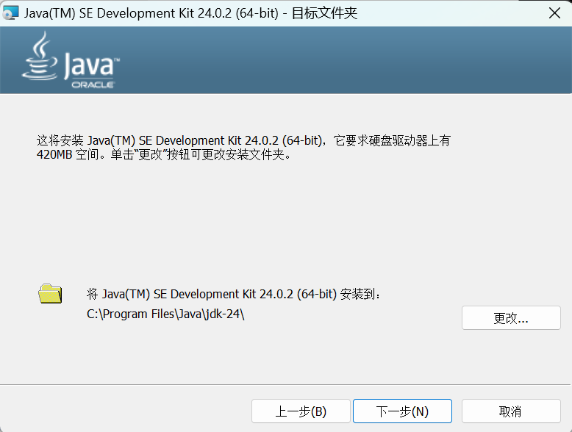
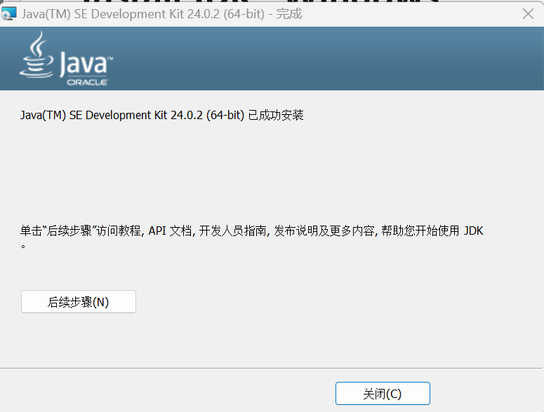

Install JDK - Windows
Check your storage space. You need 420MB.
Change your route of installation here.
Completed.

Slide 5
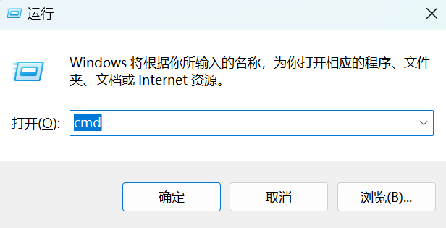
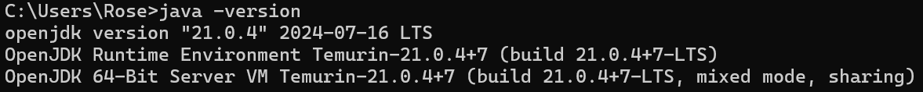
Verify JDK installation
Use cmd to check whether you have successfully installed JDK
1.Press Win+R.
2.Input cmd, and then return.
3.Input java –version.
If it turns out to be something similar, then you’ve completed the step.
(version “21.0.4” for instance. You may see version “24.0.2” on your computer.)

Slide 6

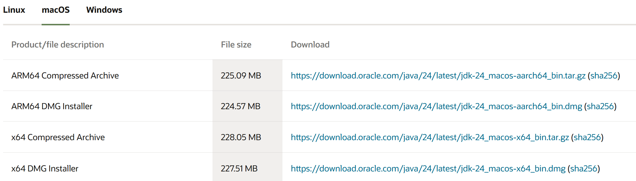
Install JDK - MacOS
https://www.oracle.com/cn/java/technologies/downloads/#jdk24-mac
Check your version:
Press Command + Space and enter Terminal.
Enter uname –a
If the output ends with “arm64”, choose Option 1; otherwise, choose Option 2
Option 1
Option 2

Slide 7
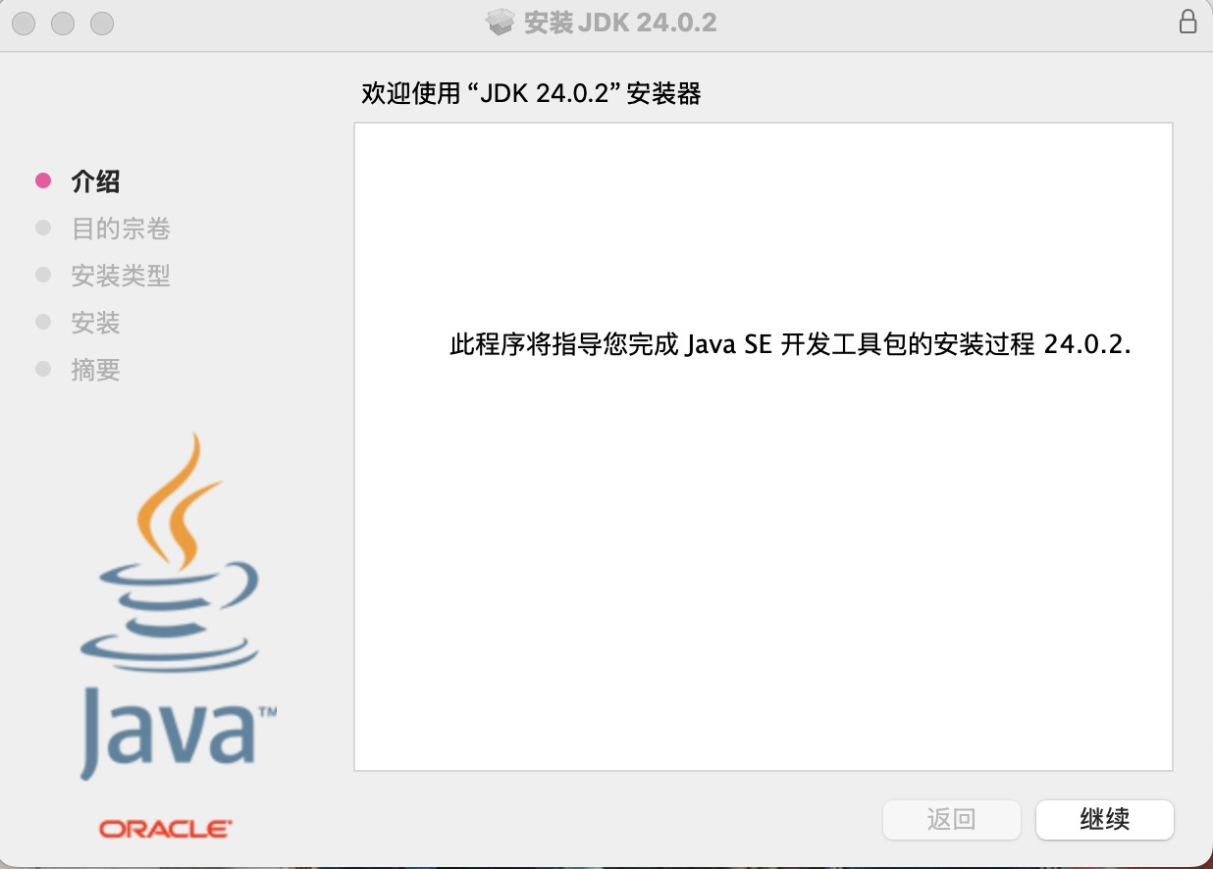
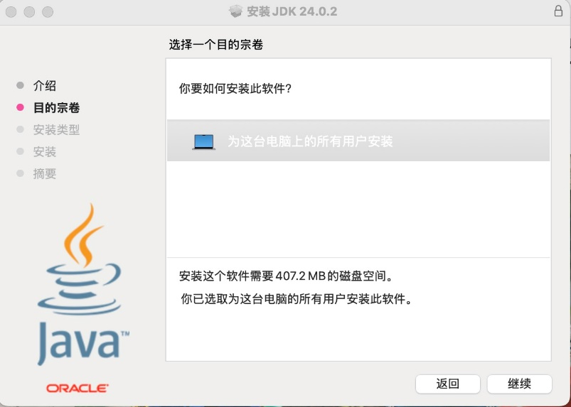

Install JDK - MacOS
Double click
Continue
Continue

Slide 8
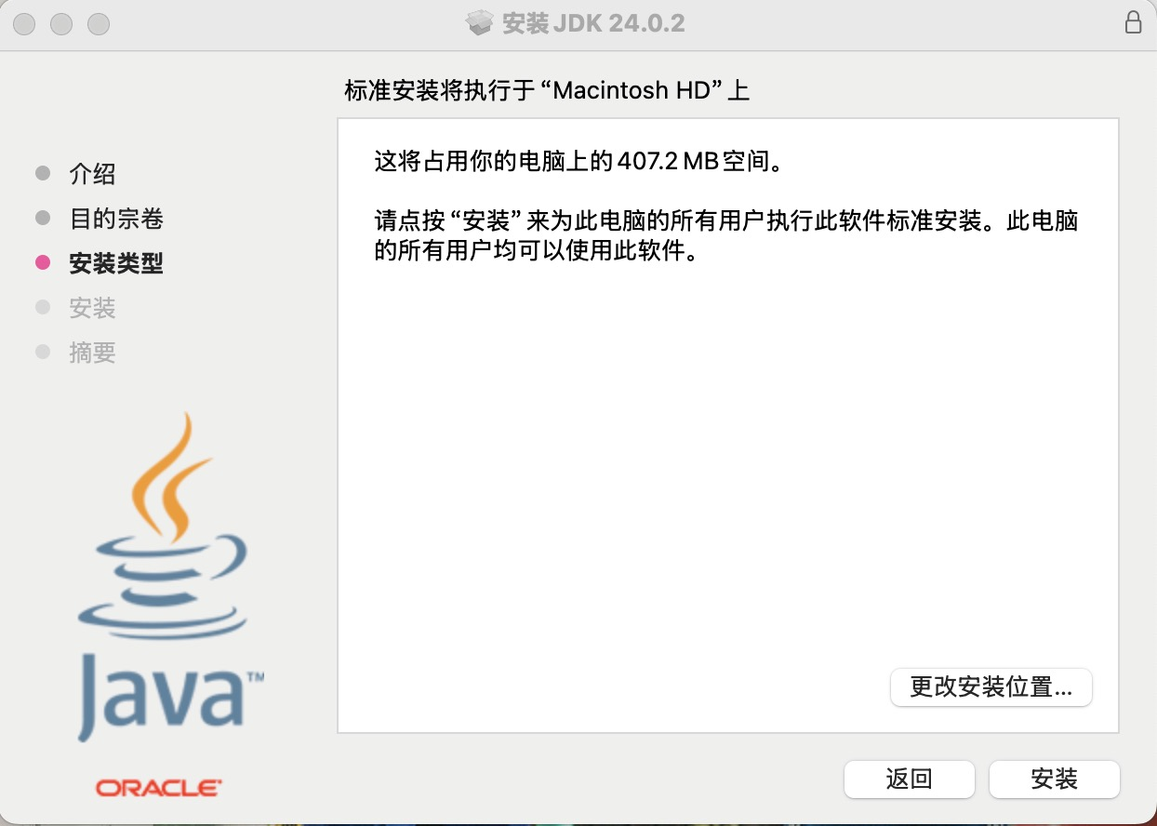
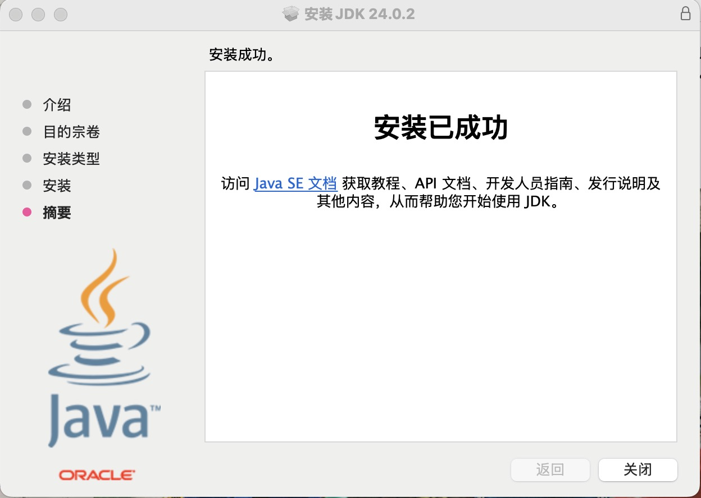
Install JDK - MacOS
Check your storage space. You need 407.2MB.
Install
Completed
Change your route of installation here.

Slide 9
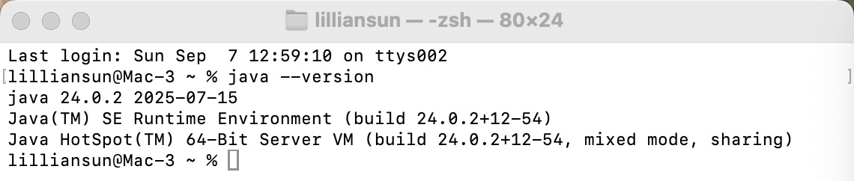
Verify JDK installation
Press Command + Space. Then enter terminal.
Input java --version
If you have similar output, you’ve successfully installed JDK24.

Slide 10
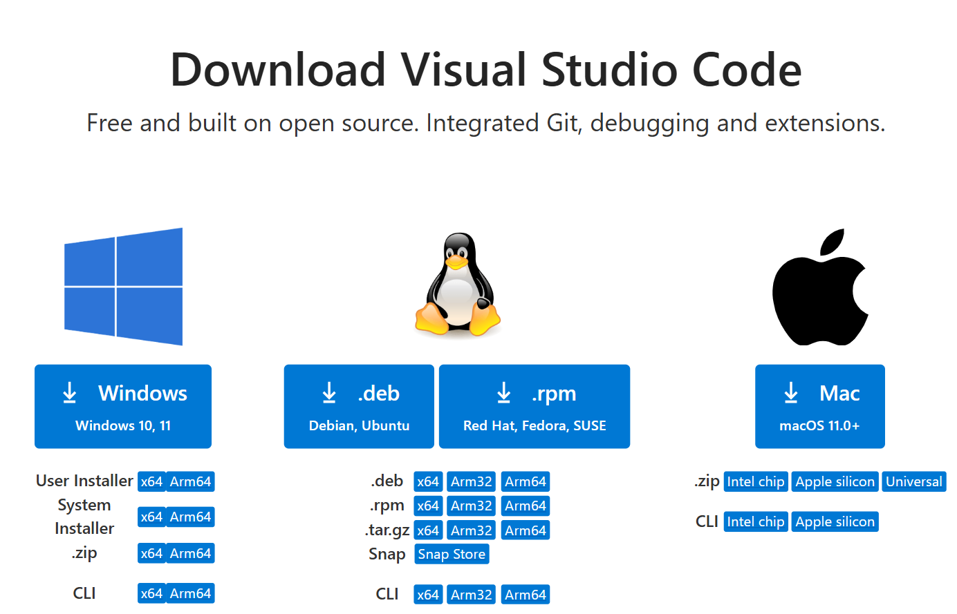
D
Download & install VSCode
Download VS Code:
  Official Website: https://code.visualstudio.com/
Install VS Code:
  Follow the same operations when installing new applications on your platform.

Slide 11
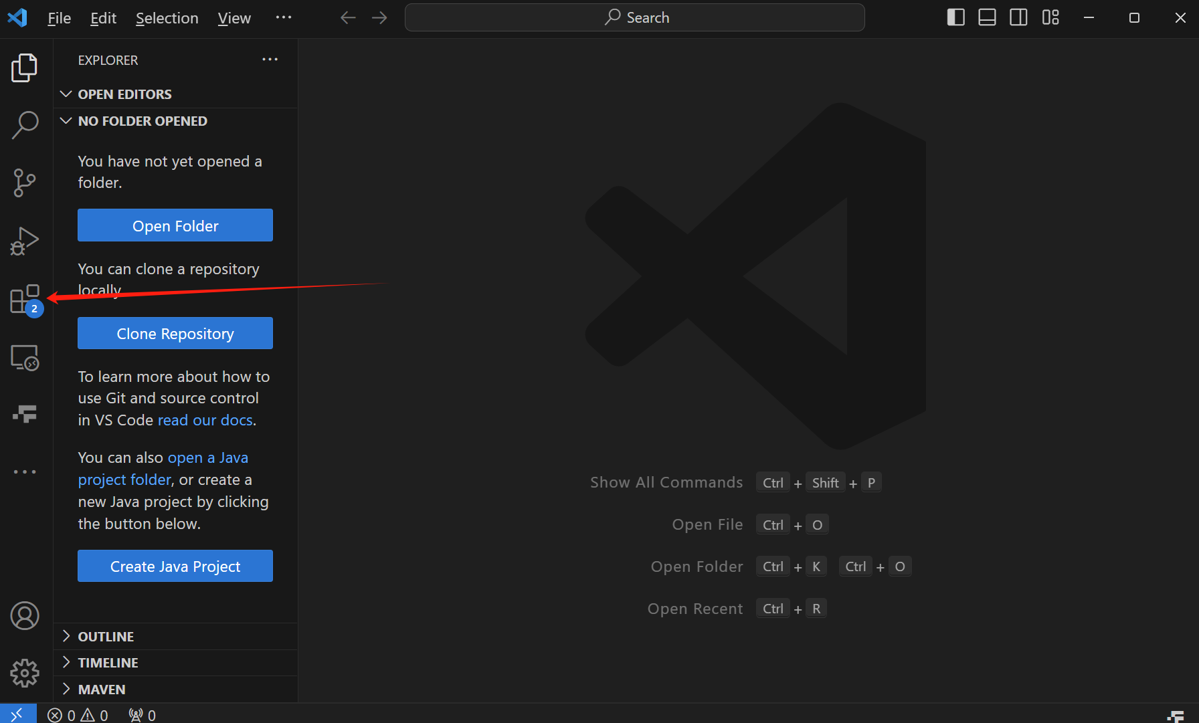
VSCode: Install Java Extension
Click the button to open the extension interface

Slide 12
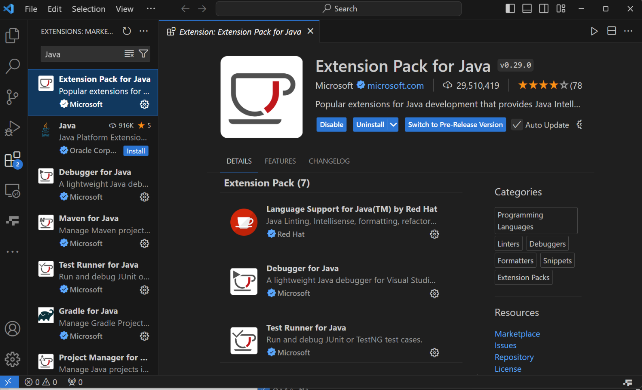
VSCode: Install Java Extension
Search “Java”, and install “Extension Pack for Java”

Slide 13
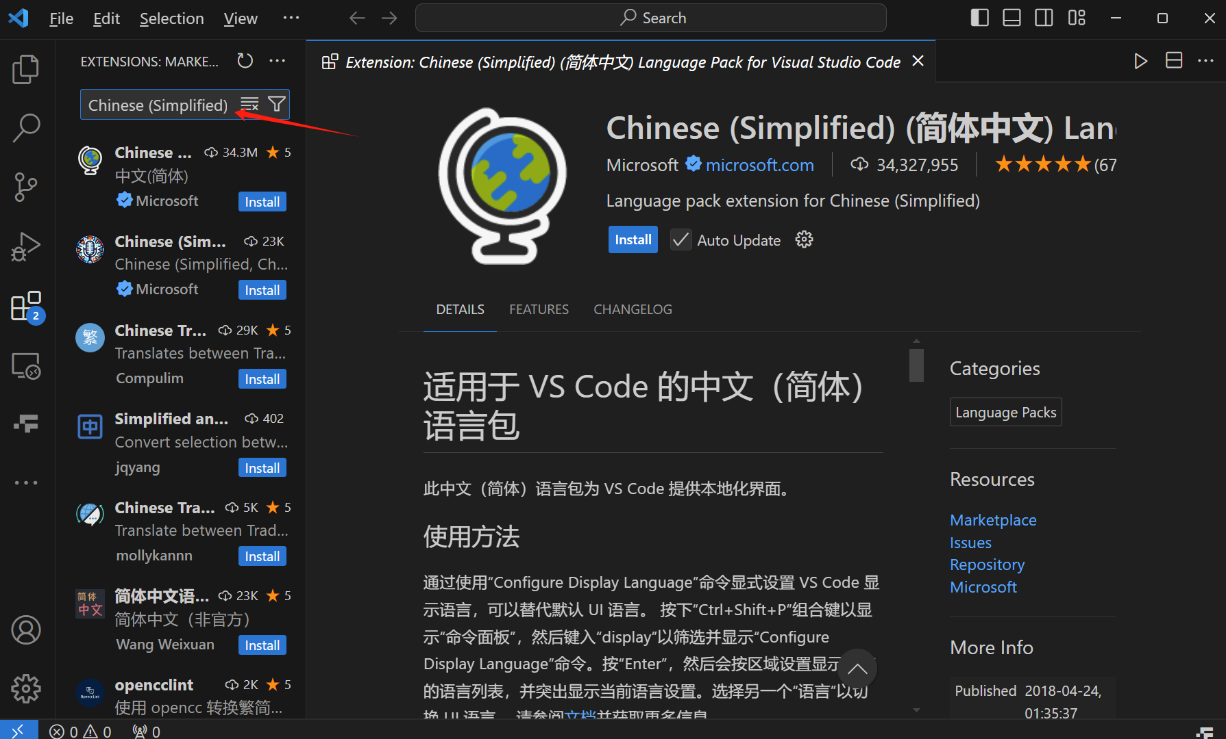
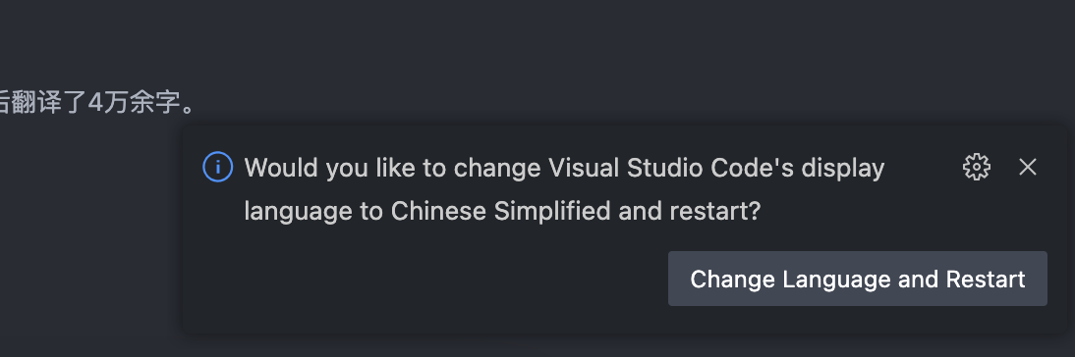
VSCode: Install Simplified Chinese
Search “Chinese (Simplified)”
And click “Install”.
Choose Change Language and Restart when installed.

Slide 14
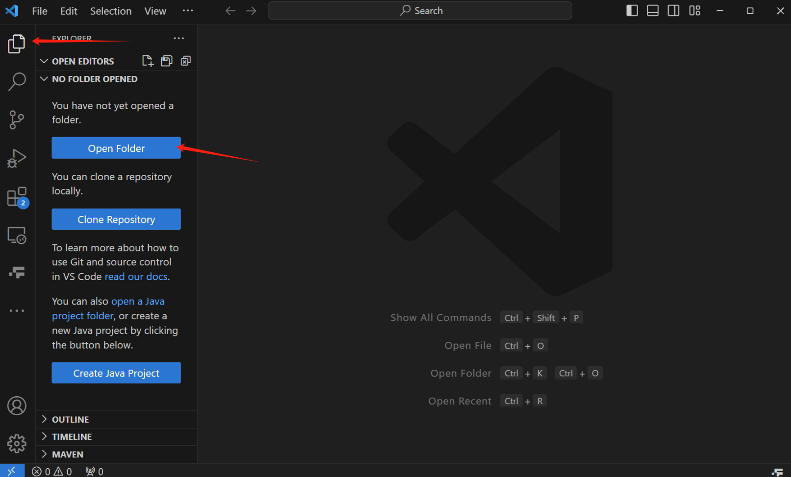
VSCode: Begin your first program
Choose “Explorer” menu, and click “Open Folder” (You can create a new folder first)

Slide 15
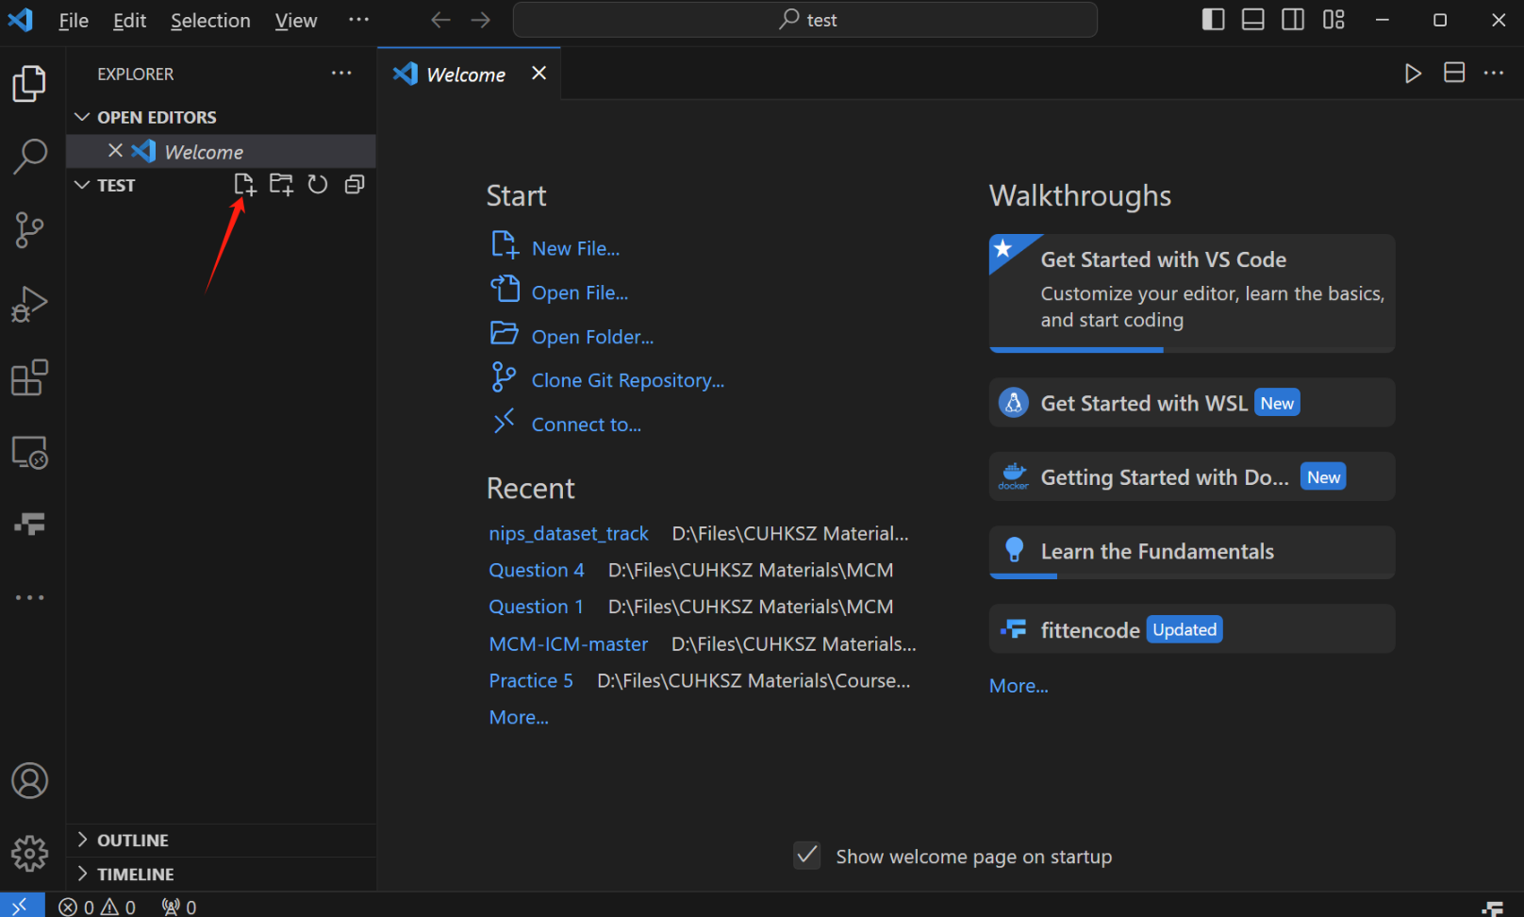
VSCode: Begin your first program
Click the “New File” button, and name it as “xxxx.java”. Now you can try writing and running code!

Slide 16
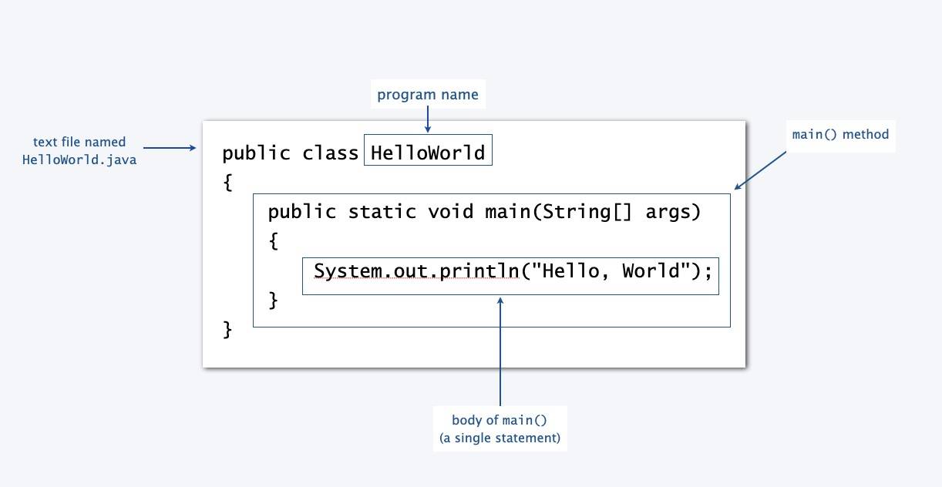
Your first program
Goal
1. Use either multiple virtual ternimals or Integrated Development Environment(IDE) to run the first Java program: HelloWorld. (The code for HelloWorld is in lecture notes)
2. Use either multiple virtual ternimals or Integrated Development Environment(IDE) to pass arguments to Java program. For example, run the following program with arguments. (can be optional)

Slide 17
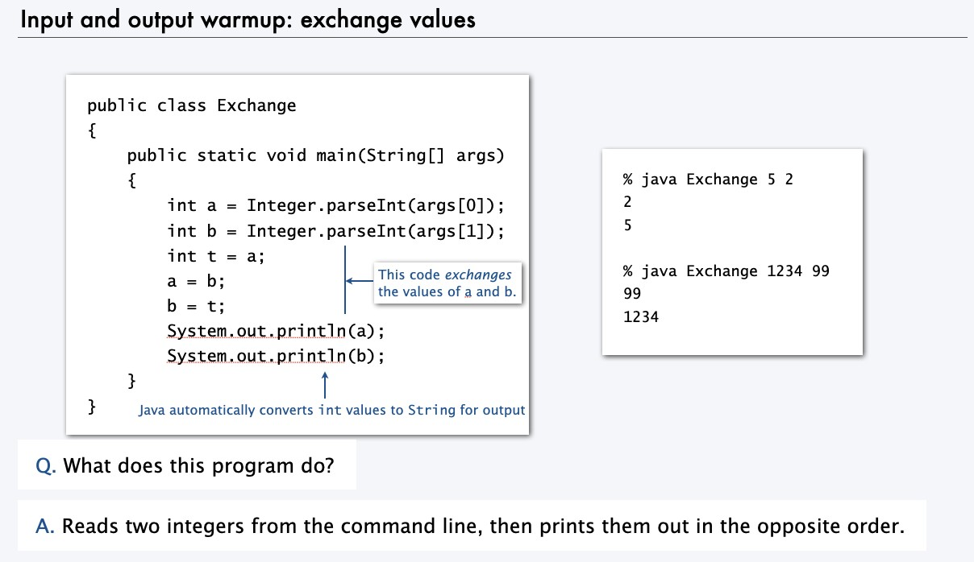
Your first program
More related materials
About passing arguments to Java program in IDEs, e.g., Eclipse and IntelliJ: https://stackoverflow.com/questions/19646719/eclipse-command-line-arguments
https://stackoverflow.com/questions/2066307/how-do-you-input-command-line-arguments- in-intellij-idea

Slide 18
Q&A

